Slide 1
Machine Learning
Part I

Slide 2
What is Machine Learning?
it is a subfield of AI
uses algorithms and statistical models
rely on pattern and inference
no need for explicit instructions
Notes:
Train the model with an image over and over using an algorithm

Slide 3
How is ML being used?
weather forecasting
medical research
business forecasting
catching fraudulent credit card activity
strategies in sports

Slide 4
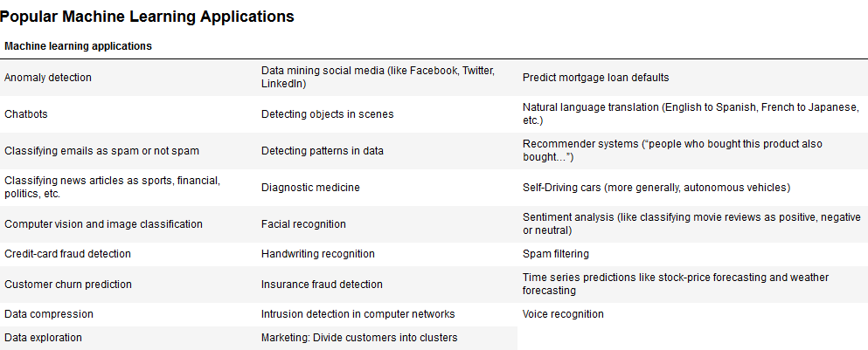
How is ML being used?

Slide 5
Scikit-Learn library
also called sklearn
packages the most effective machine-learning algorithms (estimators)
encapsulated so you don’t see the details of the algorithms (nor need to know!)
Just like your car

Slide 6
Scikit-Learn library
create models for data analysis, extracting insights and making predictions
train your model on a subset of data
test your model on the rest of the data
put it to work – make predictions on data that the model has not seen yet
Notes:
Train, Test, Predict

Slide 7
Which estimator to use?
You’ll want to experiment with lots of different models on different kinds of datasets.
try many models and pick the one that performs best.
scikit-learn makes it easy for you to “try ’em all.”

Slide 8
Type of ML
Supervised ML – works with labeled data
training your model to recognize objects that are labeled so it can classify the object (such as a dog photos that may be labeled ‘dog’)
Unsupervised ML – works with unlabeled data
putting your model to work to classify objects that are not labeled based on the training under the supervised approach (such as recognizing an object as a dog without it being labeled
the more data you feed your training model the more accurate results you can expect
Notes:
We’re using supervised ML

Slide 9
Supervised ML
you train your ML models on datasets that consist of rows and columns
each row is a data sample
each column is a feature of that sample
each sample has an associated label called a target (such as a dog or a cat)
The target is the value that you want your model to predict for new data that is presented to your model
Notes:
The more you feed the model, the better. Unstructured data into structured data.

Slide 10
Supervised ML
Supervised ML falls into 2 categories – Classification and Regression
Classification models – predict the discrete classes (categories) to which samples belong
Binary classification – uses just 2 classes, it will fall into one or the other (such as “spam” or “not spam”)
Multi-classification – uses more than 2 classes. An example would be looking at movie descriptions and trying to classify them as “action,” “adventure,” “fantasy,” “romance,” “history”, etc.

Slide 11
Supervised ML
Regression models predict a continuous output.
SciKit-Learn is bundled with a LinearRegression estimator. You can use it to perform simple linear regression or multiple linear regression.
The LinearRegression estimator uses all the numerical features in a dataset to make more sophisticated predictions than a single-feature simple linear regression

Slide 12
Unsupervised ML
No labels are given to the learning algorithm. It is left on its own to find structure in its input.
clustering algorithm – the goal of this algorithm is to find similarities in the datapoint and group similar data points together.
Using Dimensionality Reduction (scikit-learn’s TSNE estimator) we can compress a variety of a dataset’s multiple features into a few key features to create a clustering model

Slide 13
Steps in a Typical Data Science Study
loading the dataset
exploring the data with pandas and visualizations
transforming your data (converting non-numeric data to numeric data)
splitting the data for training and testing
creating the model
training and testing the model
tuning the model and evaluating its accuracy
making predictions on live data that the model hasn’t seen before.

Slide 14
Supervised Case Study using Classification
To process mail efficiently and route each letter to the correct destination, postal service computers must be able to scan handwritten names, addresses and zip codes and recognize the letters and digits
In this case study we will attempt to predict the distinct class to which a sample belongs, i.e. predict which digit an image represents
use the K-nearest neighbors(K-NN) classification model to recognize handwritten digits
There are 10 possible classes (0-9)
Train the classification model using labeled data
Notes:
Classification Model for each image to belong to a discrete class.

Slide 15
Digit’s Dataset
subset of the UCI ML hand-written digits dataset
original contains 5620 samples – 3823 for training and 1797 for testing
Digits dataset (prebundled with scikit-learn) contains only the 1797 testing samples
Each sample has 64 features (attributes) that represent an 8-by-8 image with pixel value 0-16
Notes:
Each feature (64) has a number with the intensity of the pixel.

Slide 16
Prepare work environment
create a new folder and open it in VS Code (Machine Learning)
create a virtual environment and name it ml_venv
activate your virtual environment
install the sklearn library – pip install sklearn
install additional libraries – pandas, seaborn and matplotlib

Slide 17
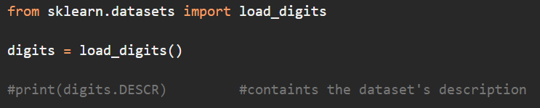
Load the Dataset
use the load_digits Function
it returns a Bunch object that contains digit samples and metadata
a Bunch is a dictionary with additional dataset-specific attributes

Slide 18
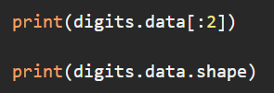
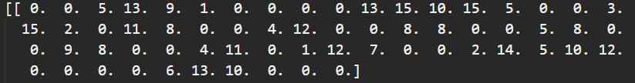
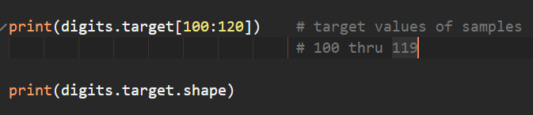

Checking the Sample and Target Sizes
The Bunch object has data and target attributes that are NumPy arrays
data array: The 1797 samples (digit images), each with 64 features with values 0 (white) to 16 (black), representing pixel intensities
target array: The images’ labels, (classes) indicating which digit each image represents

Slide 19
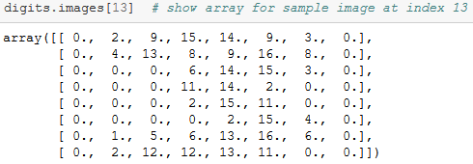

A Sample Digit Image
Images are two-dimensional—width and a height in pixels
The Bunch object has an image attribute that is a Numpy array of type float that represents the pixel intensity for each pixel in an 8-by-8 image
This example shows the image ‘3’ represented in a 8-by-8 grid and the corresponding NumPy array that shows the pixel intensity for each cell in the grid

Slide 20
Preparing the Data for Use with Scikit-Learn
Scikit-learn estimators require samples to be stored in a two-dimensional array of floating-point values
Each row represents one sample
Each column in a given row represents one feature for that sample
Multi-dimensional data samples must be flattened into a one-dimensional array

Slide 21
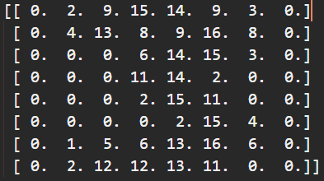


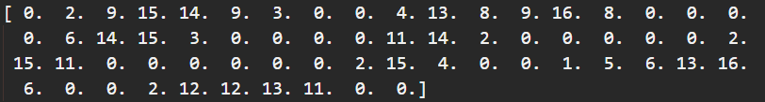
Preparing the Data for Use with Scikit-Learn
8-by-8 array digits.images[13] corresponds to 1-by-64 array digits.data[13]

Slide 22
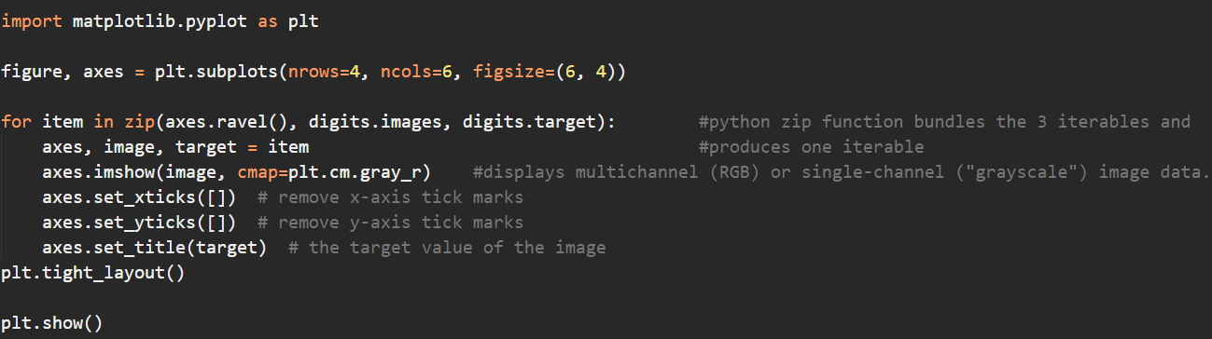
Visualizing the Data
Always familiarize yourself with your data—called data exploration

Slide 23
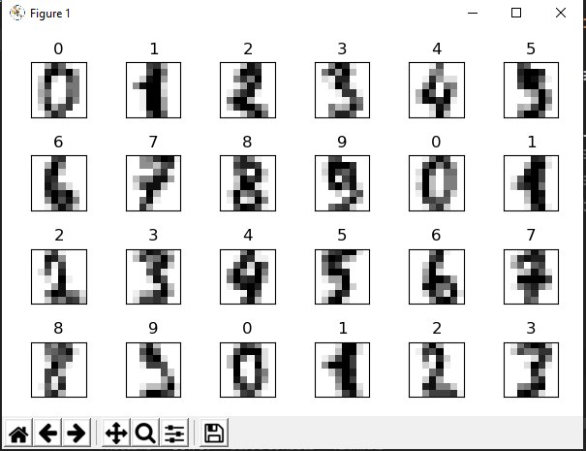
Visualizing the Data
Here we see that the image and the target match up (the target is the title above the image)

Slide 24
Splitting the Data for Training and Testing
Typically train a model with a subset of a dataset
Save a portion for testing, so you can evaluate a model’s performance using unseen data
Function train_test_split shuffles the data to randomize it, then splits the samples in the data array and the target values in the target array into training and testing sets
Shuffling helps ensure that the training and testing sets have similar characteristics
Returns a tuple of four elements in which the first two are the samples split into training and testing sets, and the last two are the corresponding target values split into training and testing sets

Slide 25
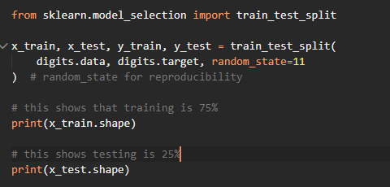

Training and Testing Set Sizes
By default, train_test_split reserves 75% of the data for training and 25% for testing
x_train and x_test – samples
y_train and y_test – target values

Slide 26
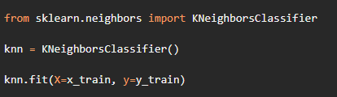
Creating the Model
In scikit-learn, models are called estimators
KNeighborsClassifier estimator implements the k-nearest neighbors algorithm
Train the model using the ‘fit’ method
A ‘fit’ method of a model typically loads the data into the model and performs complex calculations. The KNeighborsClassifier fit method just loads the data but does not perform any calculations (training)

Slide 27
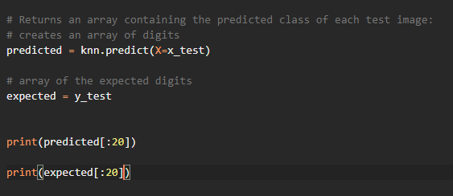

Creating the Model
Lots of models have significant training phases that can take minutes, hours, days or more
High-performance GPUs and TPUs can significantly reduce model training time
Using the predict method we can return the predicted class of each test image

Slide 28
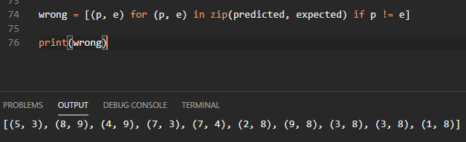
Creating the Model
Locate all incorrect predictions for the entire test set:

Slide 29
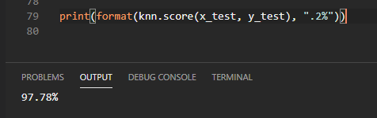
Metrics for Measuring Model Accuracy
Using the score method we can see how well the estimator (model) performs on test data
For the classification estimator, it returns the prediction accuracy for the test data

Slide 30
Confusion Matrix

Slide 31

Confusion Matrix
Row 0 shows digit class 0—all 0s were predicted correctly
Row 8 shows digit class 8—five 8s were predicted incorrectly
Correctly predicted 88.63% (39 of 44) of 8s
8s harder to recognize

Slide 32
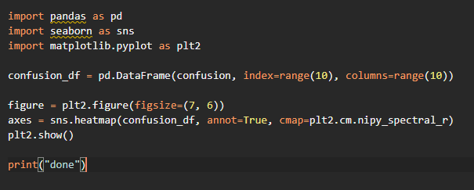
Visualizing the Confusion Matrix
A heat map displays values as colors
Convert the confusion matrix into a DataFrame, then graph it
Principal diagonal and incorrect predictions stand out nicely in heat map
You will need to pip install pandas and seaborn (for heat map)

Slide 33
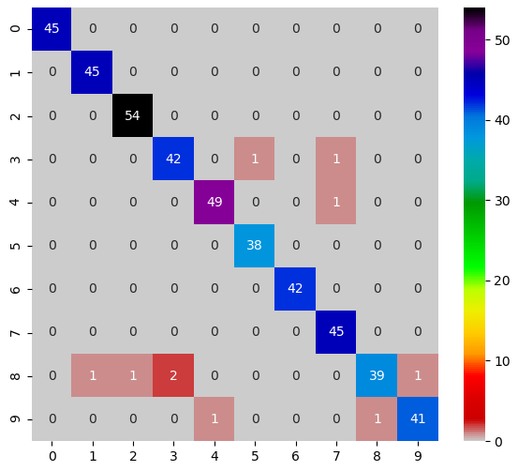
Visualizing the Confusion Matrix

